Slide 1
Spiritual Gifts III: Church Lego
June 1, 2019

Slide 2
What is a Spiritual Gift?
A special attribute given by the Holy Spirit to every member of the Body of Christ, according to God’s grace, for use within the context of the body.

Slide 3
1 Corinthians 12:4-6
⁴ Now there are varieties of gifts, but the same Spirit; ⁵ and there are varieties of services, but the same Lord; ⁶ and there are varieties of activities, but it is the same God who activates all of them in everyone.

Slide 4
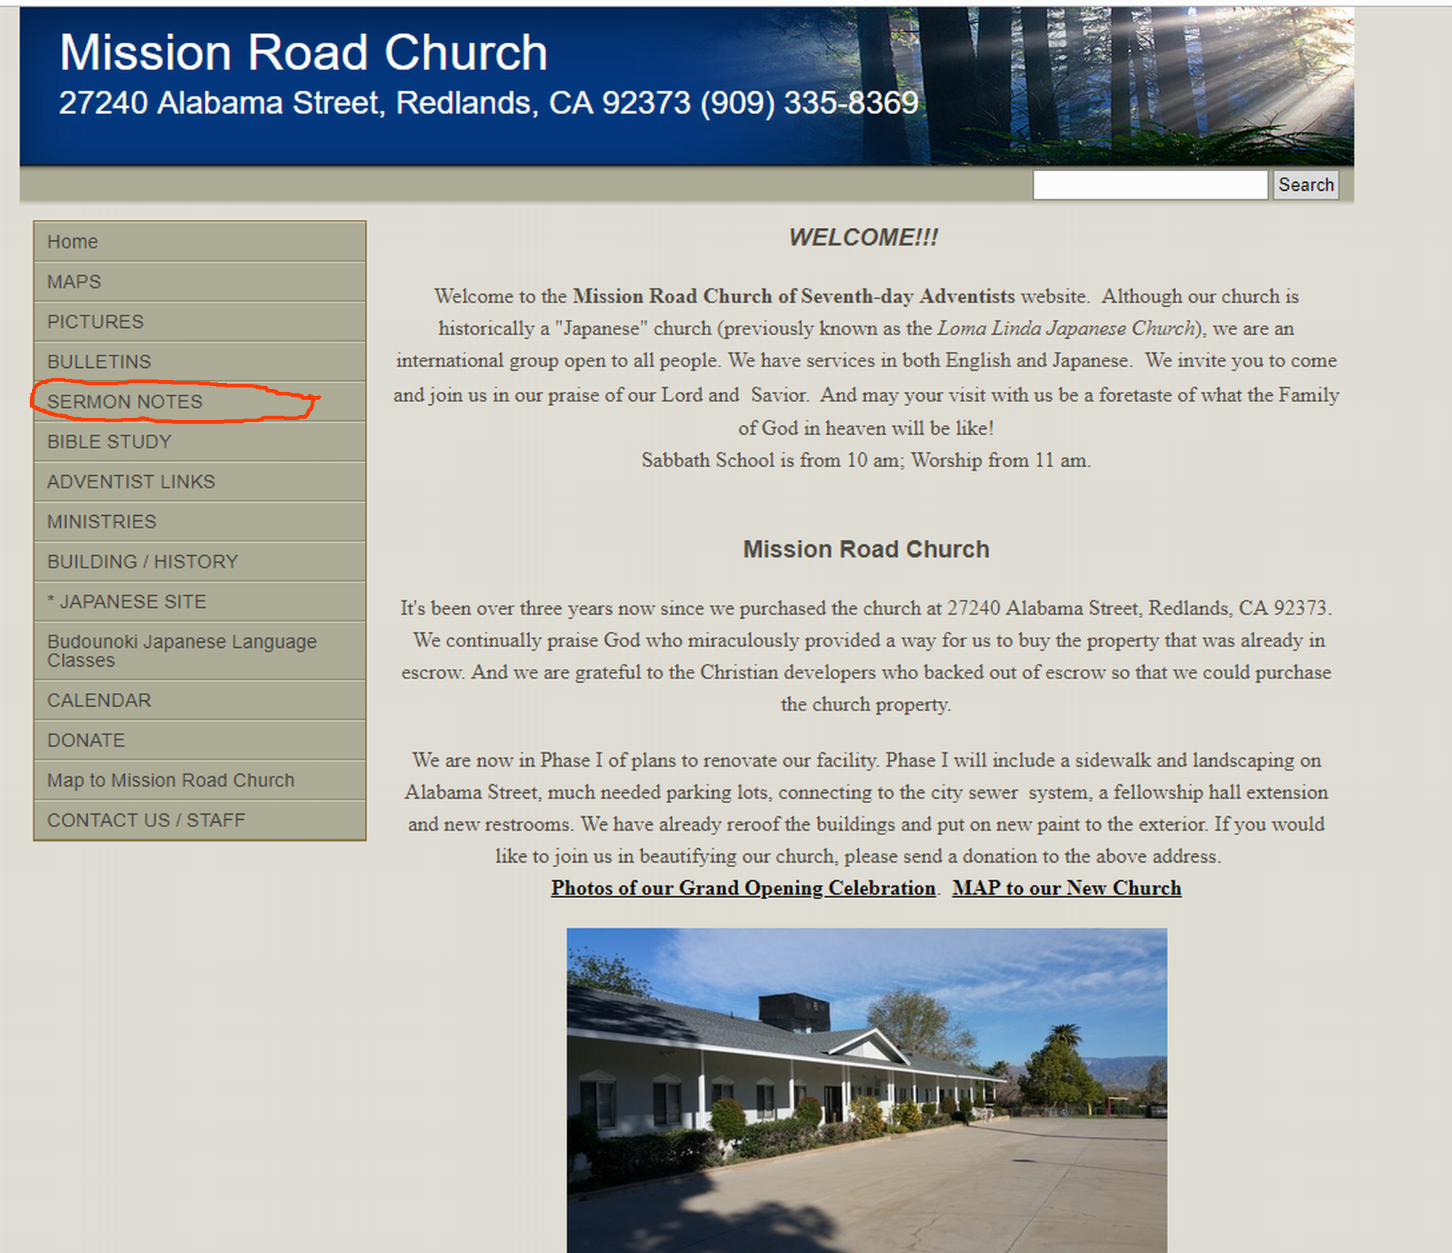

Slide 5
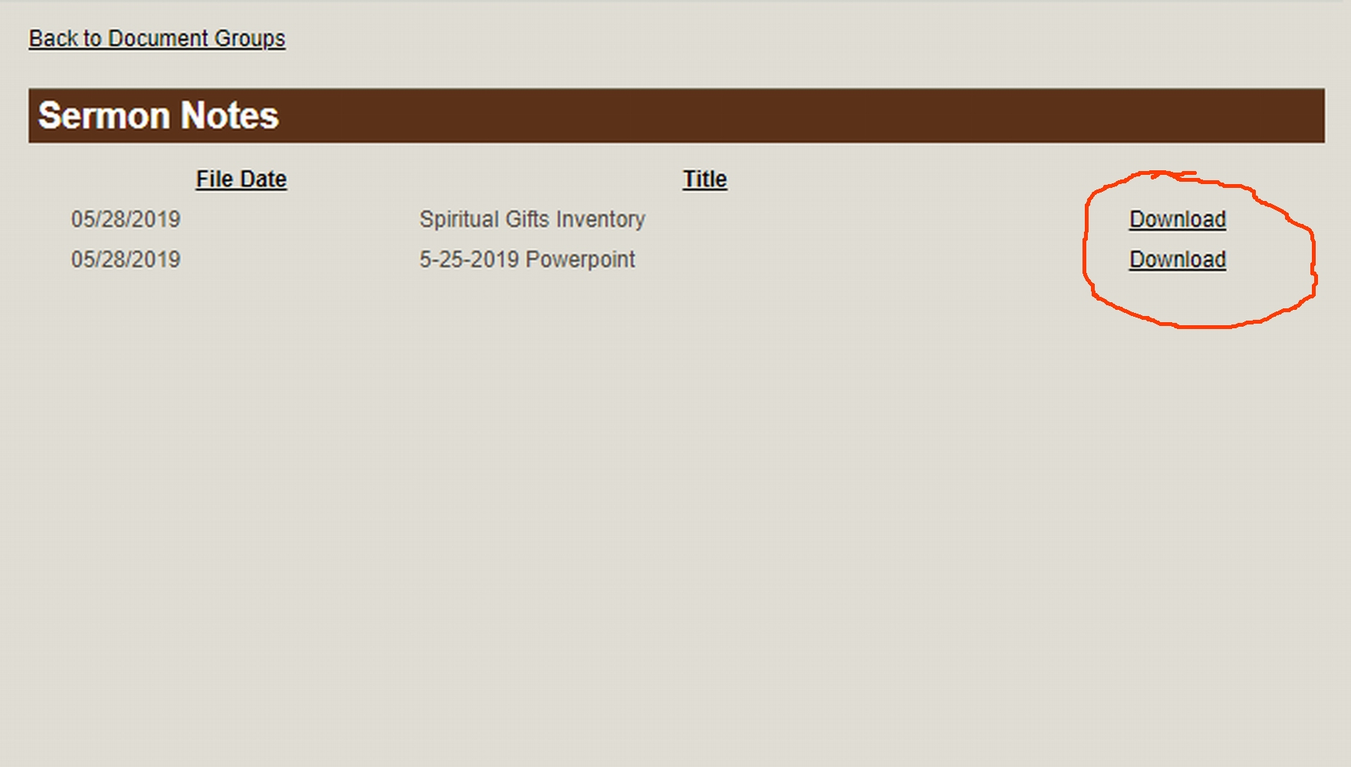

Slide 6
Administration (1 Cor. 12:28)
The ability to understand what makes an organization function
Develop strategies to reach goals, organize people, tasks, and events
Help ministries become more effective and efficient

Slide 7
Apostleship (1 Cor. 12:28; Eph. 4:11)
The ability to start and oversee the development of new churches or ministries
Desire to minister to unchurched people
Take responsibility to oversee new ministries or churches

Slide 8
Crafting/Craftsmanship (Ex. 35:30-33)
The divine enablement to creatively design or construct items to be used for ministry
Serve with their hands to meet needs of ministries
Skilled in working with different raw materials
Can be traditional materials (wood, cloth, glass) or computer/internet assets!

Slide 9
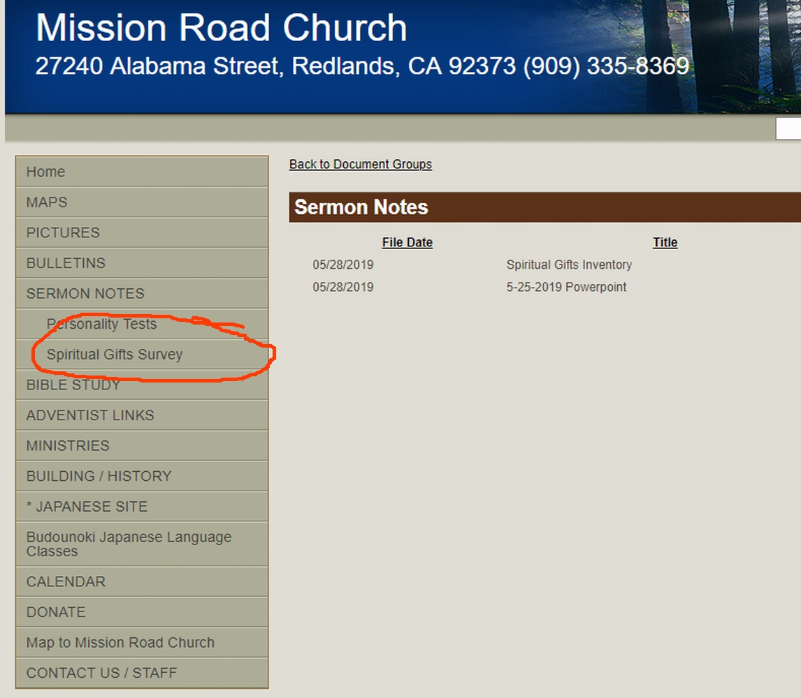

Slide 10
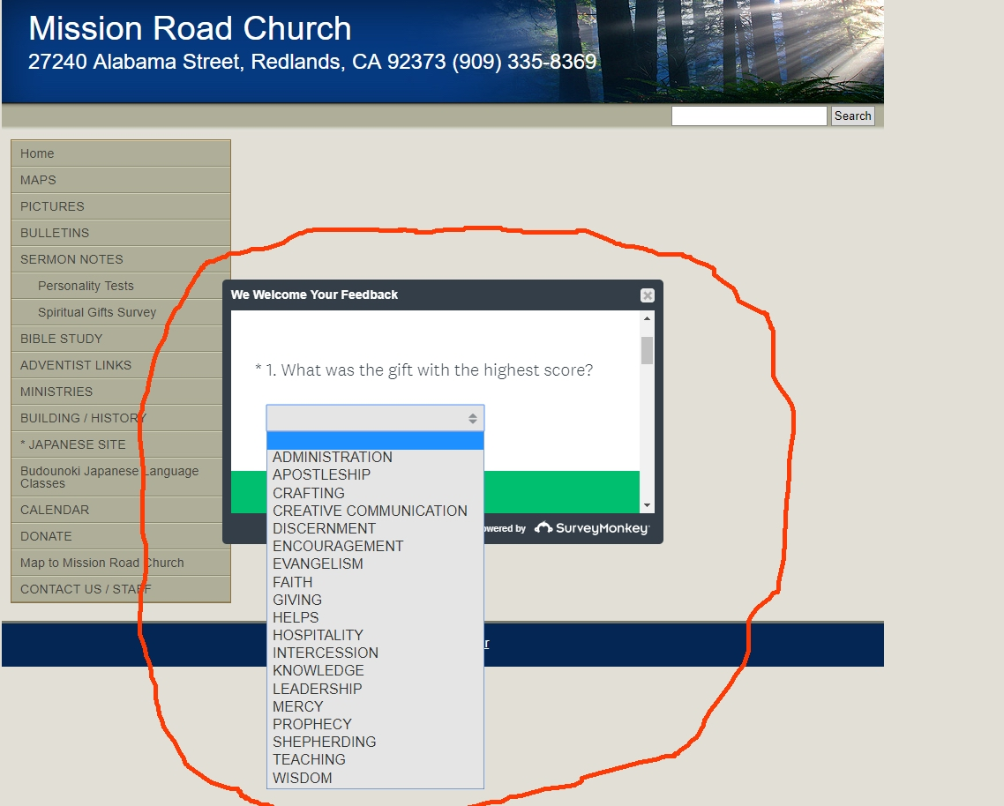

Slide 12
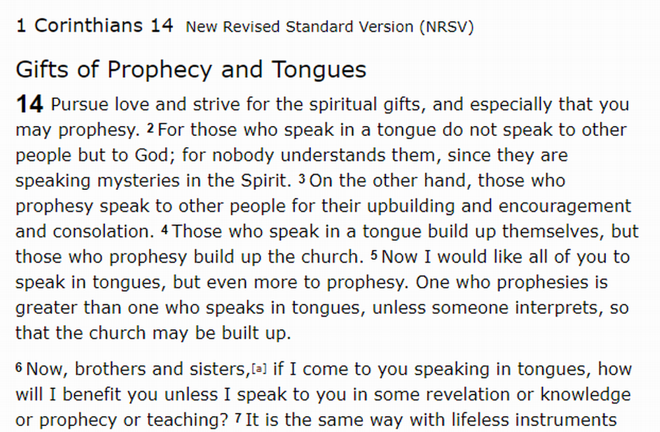

Slide 13
1 Thessalonians 5:19
¹⁹ Do not quench the Spirit.
(Or, “Stop quenching the Spirit”)

Slide 14
What is a Spiritual Gift?
A special attribute given by the Holy Spirit to every member of the Body of Christ, according to God’s grace, for use within the context of the body.

Slide 15
for use within the context of the body.

Slide 16
1 Corinthians 14:30-33
³⁰ If a revelation is made to someone else sitting nearby, let the first person be silent. ³¹ For you can all prophesy one by one, so that all may learn and all be encouraged. ³² And the spirits of prophets are subject to the prophets, ³³ for God is a God not of disorder but of peace.

Slide 17
John 1:32-34
³² And John testified, “I saw the Spirit descending from heaven like a dove, and it remained on him. ³³ I myself did not know him, but the one who sent me to baptize with water said to me, ‘He on whom you see the Spirit descend and remain is the one who baptizes with the Holy Spirit.’ ³⁴ And I myself have seen and have testified that this is the Son of God.”

Slide 18
John 14:16-17
¹⁶ And I will ask the Father, and he will give you another Advocate, to be with you forever. ¹⁷ This is the Spirit of truth, whom the world cannot receive, because it neither sees him nor knows him. You know him, because he abides with you, and he will be in you.

Slide 19
παρακλητος
Para “Alongside”
Kaleo “Call”
Called alongside, called to; Stand beside, encourage, defend, advocate

Slide 20
John 14:25-27
²⁵ “I have said these things to you while I am still with you. ²⁶ But the Advocate, the Holy Spirit, whom the Father will send in my name, will teach you everything, and remind you of all that I have said to you.

Slide 21
²⁷ Peace I leave with you; my peace I give to you. I do not give to you as the world gives. Do not let your hearts be troubled, and do not let them be afraid.

Slide 22
John 15:26-27
²⁶ “When the Advocate comes, whom I will send to you from the Father, the Spirit of truth who comes from the Father, he will testify on my behalf. ²⁷ You also are to testify because you have been with me from the beginning.

Slide 23
John 16:7-11
⁷ Nevertheless I tell you the truth: it is to your advantage that I go away, for if I do not go away, the Advocate will not come to you; but if I go, I will send him to you. ⁸ And when he comes, he will prove the world wrong about sin and righteousness and judgment: ⁹ about sin, because they do not believe in me; ¹⁰ about righteousness, because I am going to the Father and you will see me no longer; ¹¹ about judgment, because the ruler of this world has been condemned.

Slide 24
John 14:12
¹² Very truly, I tell you, the one who believes in me will also do the works that I do and, in fact, will do greater works than these, because I am going to the Father.

Slide 25
John 4:13-14
¹³ Jesus said to her, “Everyone who drinks of this water will be thirsty again, ¹⁴ but those who drink of the water that I will give them will never be thirsty. The water that I will give will become in them a spring of water gushing up to eternal life.”

Slide 26
John 7:37-39
³⁷ On the last day of the festival, the great day, while Jesus was standing there, he cried out, “Let anyone who is thirsty come to me, ³⁸ and let the one who believes in me drink. As the scripture has said, ‘Out of the believer’s heart shall flow rivers of living water.’” ³⁹ Now he said this about the Spirit, which believers in him were to receive; for as yet there was no Spirit, because Jesus was not yet glorified.

Slide 27
Ellen White, Evangelism p. 699
“When we have entire, wholehearted consecration to the service of Christ, God will recognize the fact by an outpouring of His Spirit without measure; but this will not be while the largest portion of our church are not laborers together with God.”

